Slide 1
mNGS
Study design and sample prepration
Rapid Response – Updated September 2026

Slide 2
Key points to learn in this session
Good study is essential for mNGS an requires an understanding of:
Purpose of the study (e.g. clinical diagnostics, outbreak detection)
Pathogen landscape
Sample type
Controls
Sample selection and metadata
  Sensitivity of mNGS (e.g. are we getting enough reads?)

Slide 3

Study design

Slide 4






mNGS pipeline
Study design
xNA extraction
Library prep
Sequencing
Data analysis
Pathogen ID
Type(s)
Controls
Storage
Lab setup
Type(s)
Controls
QC
Host removal
Fragmentation
dsDNA generation
End-repair
Adapter ligation
Barcoding & PCR
Clean-up
Pooling
QC
Machine
Read length
Loading conc.
QC data
Host removal
Alignment
Blast
Ranking of hits

Slide 5


Good study design is essential for mNGS!
It requires an definition of:
Purpose of the study (e.g. clinical diagnostics, outbreak detection)

Slide 6
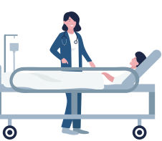

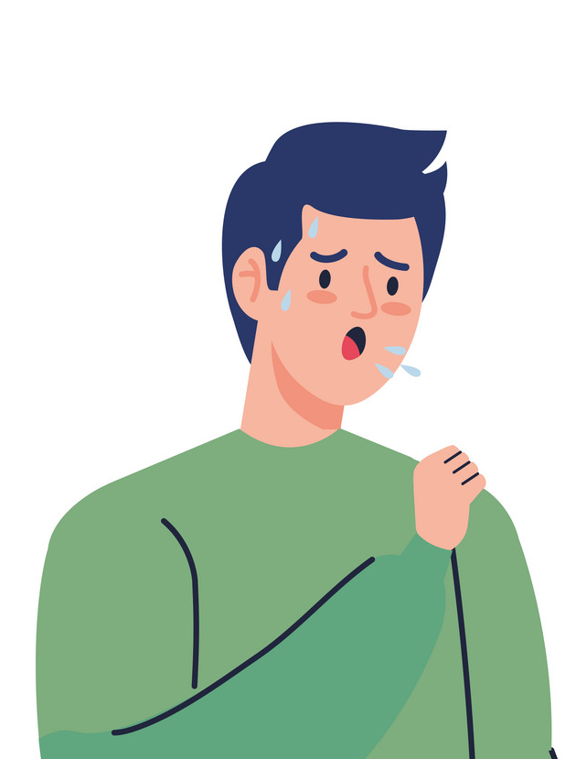


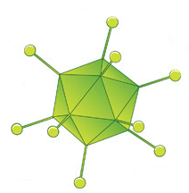

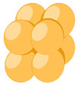



Some use cases for mNGS
Identify a novel pathogen
Outbreak detection and prevention
Identify coinfections
Characterize the microbial landscape
+

Slide 7
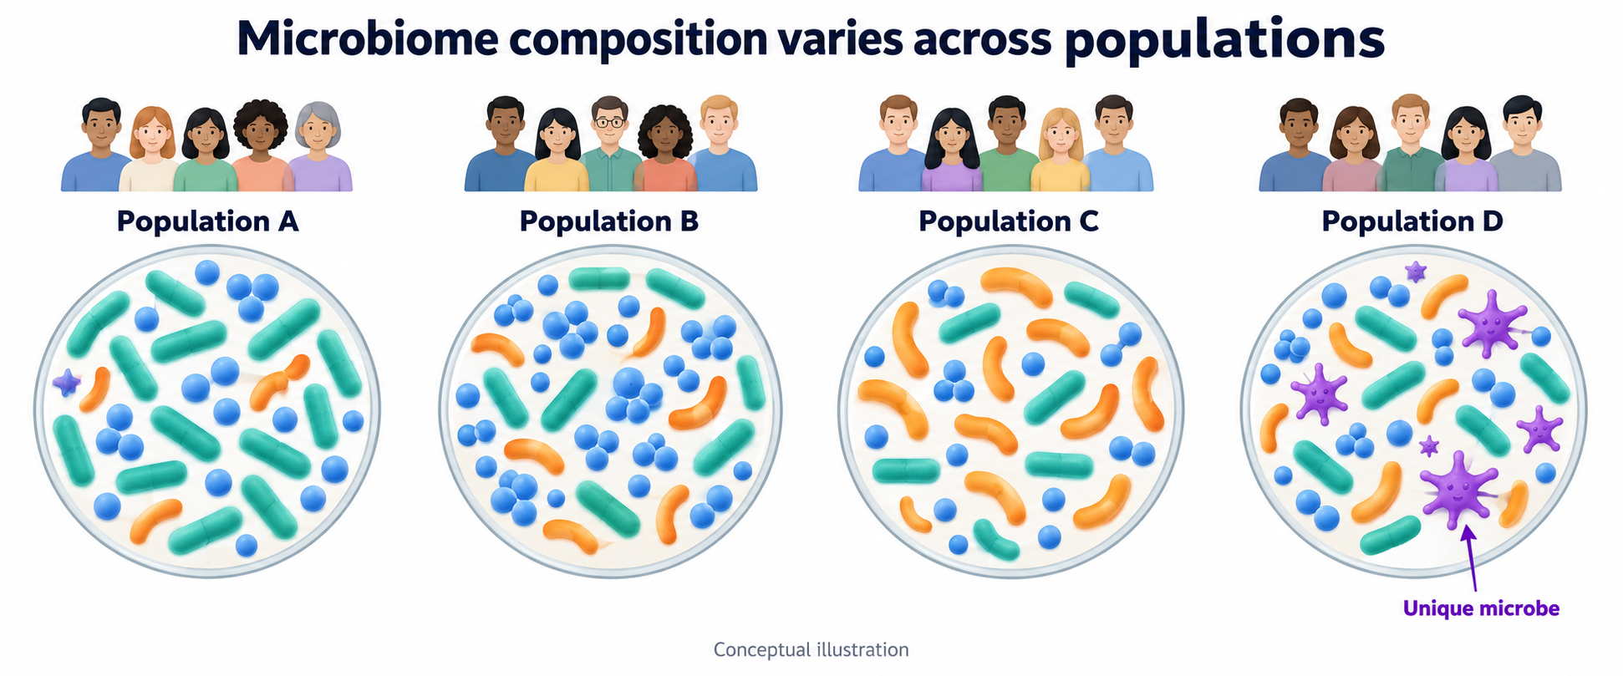
Pathogen landscape
What pathogens are suspected, what other microorganisms are we expecting
…or pathogen?

Slide 8


Sample type
How to choose the sample type? Depends on the question!
Respiratory symptoms?
Upper = NP, OP swab, saliva
Lower= Bronchial lavage, pleural fluid, lung biopsy
Neurological symptoms?
Meningitis/Encephalitis?
CSF and Serum
Systemic infection? Rash?
Serum or plasma
Neonatal infection?
Paired sample of neonatal CSF/Serum +
rectal, vaginal, or serum sample from mother
Gastrointestinal symptoms?
Stool, urine, rectal swab, vaginal swab

Slide 9
Different human sample types have different RNA contents!
Nasal or oral swab
50% microbial (mostly bacteria)
Cerebral Spinal Fluid
No infection: 0% microbial
With infection: <1% - 5%
Whole Blood: lot of background
No infection:
During infection: <<<0% microbial
Tracheal Aspirate
5% microbial, 95% human
Serum or Plasma
10-100x less host material
Host
Microbial
Rectal or Vaginal swabs or stool
50% microbial (mostly bacteria)

Slide 10

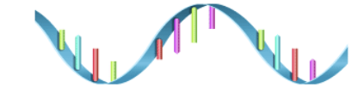

Type of nucleic acid: DNA Vs RNA
Everything that’s there
…Even if it’s dead
Well suited for pathogens with ‘large’ genomes
Can have too much host signal
Easier, faster
Everything that’s Alive
…Including that RNA virus
Most will be rRNA
RNA is labile
Excellent preservation
is mandatory
You won’t find me here!
Att: Your favorite RNA virus
In some cases, there are depletion methods available

Slide 11
Study controls are CRUCIAL to make sense of sequencing data
Healthy controls: clinical samples from healthy controls
  What are organisms that are commonly found in your population?
Sampling: mock samples (e.g. needle touching but not piercing skin during CSF sampling)
  What are the common contaminants that occur during the sampling process?
During nucleic acid extraction: water controls
  What are the common contaminants that occur during extraction?
  What is the level of cross-contamination that occurs between samples during extraction?

Slide 12




Study subject include known positive and negative samples
Study subjects
Unknown, cases of interest
Metadata
Positive controls
Fever with unknown cause
Diagnostic test results
WBC
PCR
Ab/Ag
Cultures
+
Fever with known cause
Dates
Symptoms
Location
Negative controls and potential incidental findings
Age
Healthy individuals
Notes:
Collecting samples from healthy controls is crucial!

Slide 13
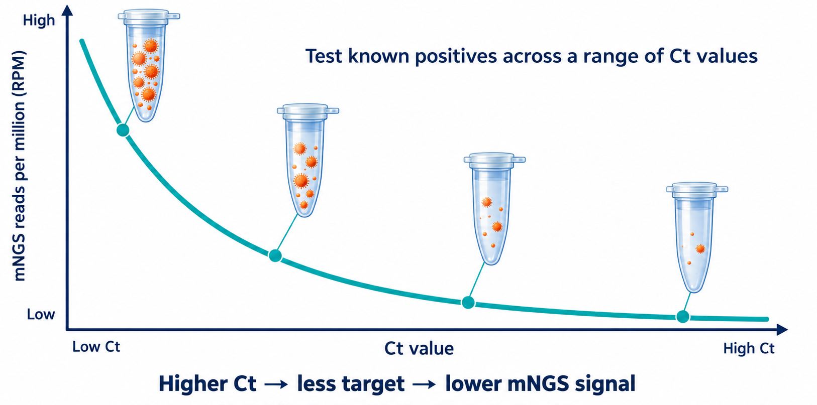
Value of positive samples to assess detection and sensibility
What if you don’t find a pathogen?
Did the experiment fail?
Positive controls are the answer, and a range of pathogen types and abundances will give you a sense of sensibility
Ideally the detection method used is dependent on the presence of nucleic acids (qPCR, etc.)

Slide 14
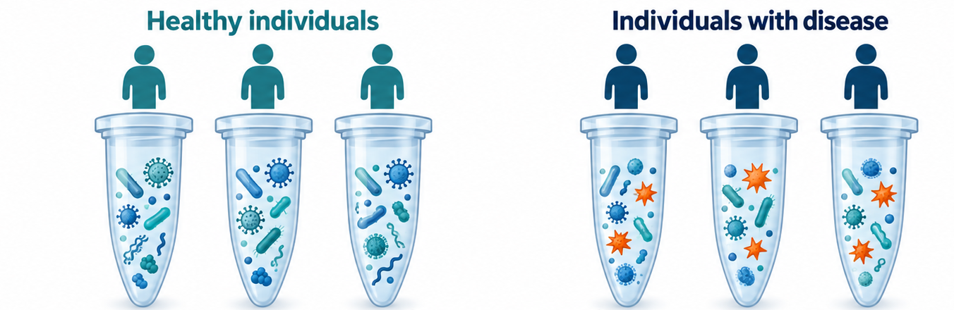
Value of negative samples to assess cross contamination, microbiological landscape and background signal
Samples from ”healthy individuals” help distinguishing background microbiota from true disease-causing agents
However association alone does not establish causation

Slide 15
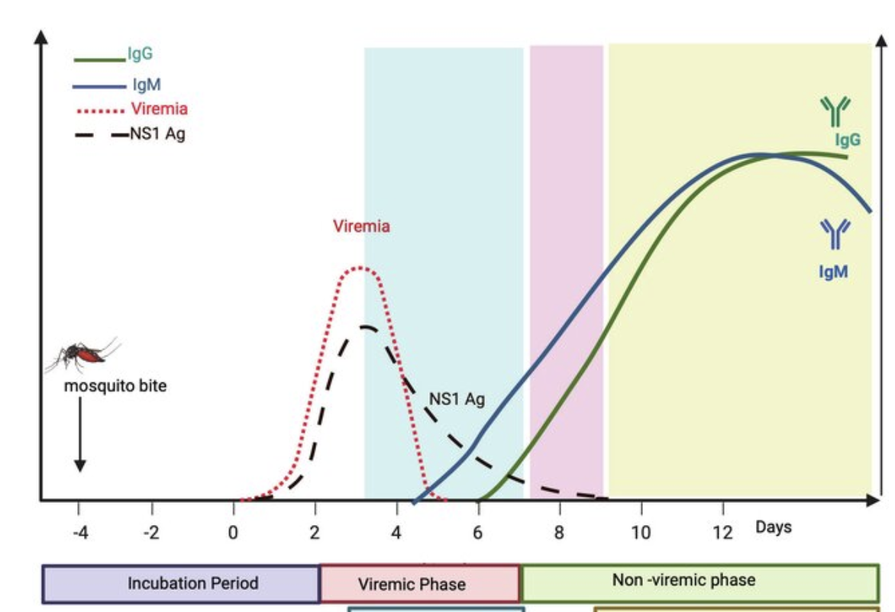
Sample selection for sequencing
When studies are retrospective consider prioritizing samples that:
Were collected during the acute phase of symptom onset
Presented severe and/or various symptoms
Had evidence for infectious etiology
Were well preserved
Have ample metadata
Prioritize positive controls tested with NA
DOI:10.5772/intechopen.1006372

Slide 16
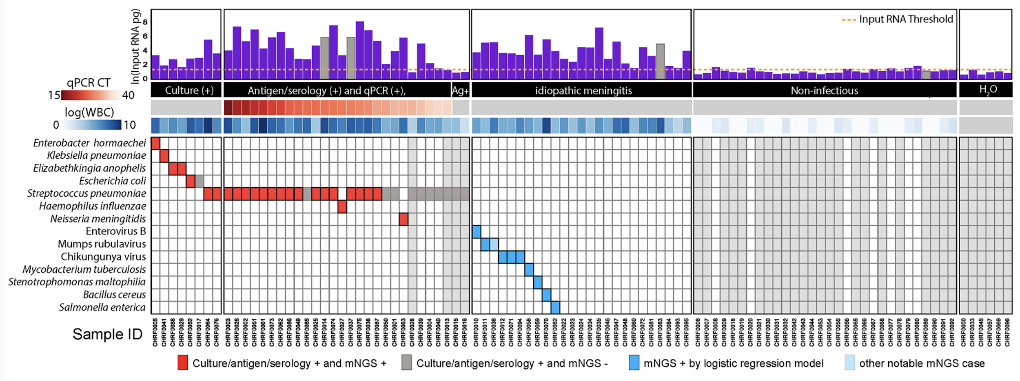
Understanding the sensitivity/specificity of mNGS
Sensitivity and specificity depend on:
  Amount and quality of sample input
  Efficiency of each step in mNGS
  Accuracy of “base calling” during sequencing
  Quality of genome database
Total input inferred from reads that mapped to the ERCC in RNA libraries
Minimum input required for analysis

Slide 17
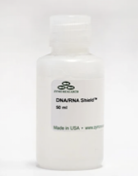
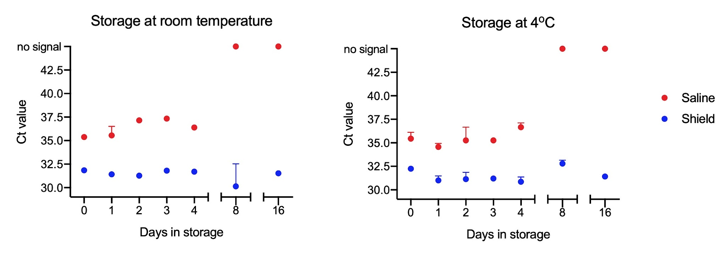
Sample preservation
Sample collection:
  Collect in nucleic acid stabilizers to preserve sample quality
    e.g. DNA/RNA Shield (Zymo), RNAlater (Qiagen)
  Prepare your own collection kits with Shield (cheaper than buying pre-made kits)
  Collect samples as sterile as possible
  Collect “collection controls”: e.g. needle touch without aspiration, ...
DNA/RNA Shield
Preserves RNA for 24 hrs at RT, indefinitely at -20ºC
Inactivates pathogens
1x Solution for solids & swabs
2x Solution for liquids
-> Order 2x and dilute ½ for swabs if needed
In vitro transcribed RNA fragments preserve better in Shield than in Saline when stored at room temperature or at 4ºC, as assessed by qPCR.

Slide 18
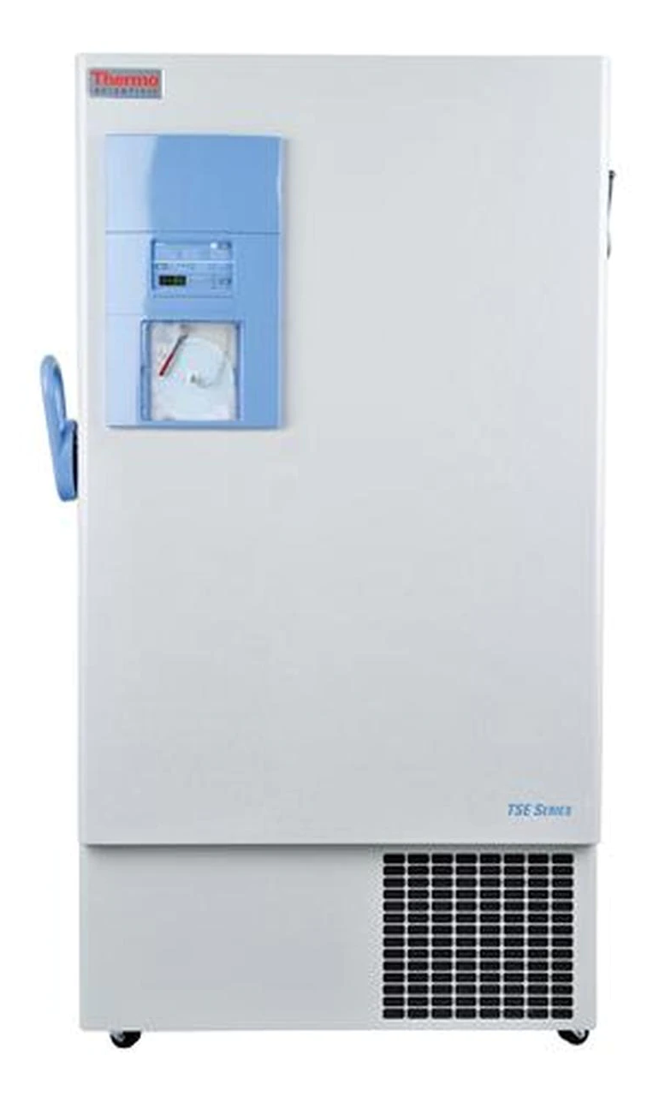
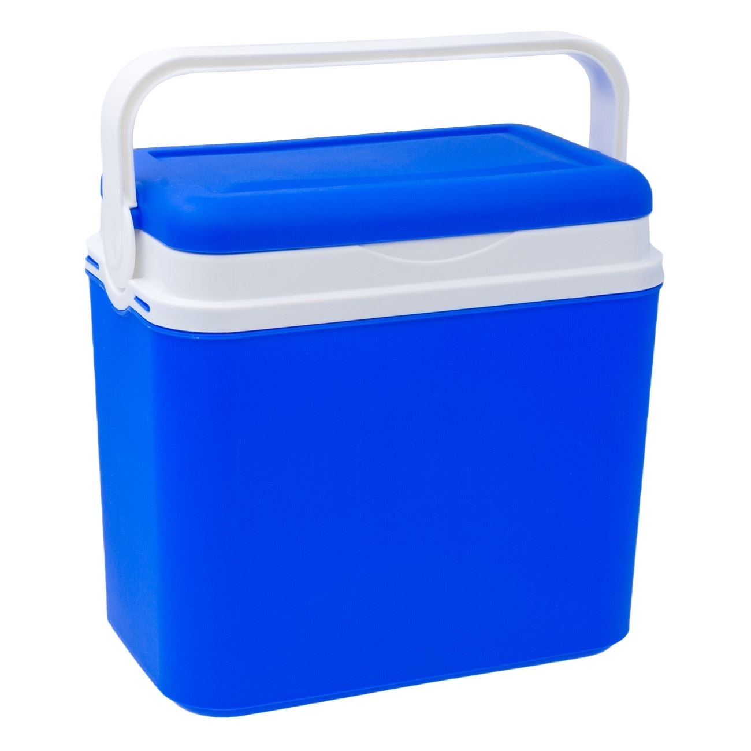
Sample storahe
Cold chain preserves sample quality
Collect in
DNA/RNA Shield
Or RNAlater
Keep cold during transport
Long term storage at -80ºC

Slide 19
Study design
Key points:
✓ Preserve sample quality
✓ Collect metadata
✓ Include controls !
✓ Minimize cross-contamination
Study subjects
  Population of interest + metadata
  Healthy controls (!)
Sample types:
  Swabs: oral, rectal, vaginal, ...
  Blood vs serum
  CSF
Sample collection:
  Collect in nucleic acid stabilizers: e.g. DNA/RNA Shield (Zymo), RNAlater (Qiagen)
  Work as sterile as possible and collect appropriate controls
Sample storage:
  Keep cold during transport (!)
  Flash freeze as soon as possible (!)

Slide 20
Example dataset - Fever with unknown etiology
 |  | Known positives |  |  |  |  |  | Unknowns |  |  |  |  |  | Known negatives |  |  |  |  |  | Water
 |  | 1 | 2 | 3 | 4 | 5 | 6 | 7 | 8 | 9 | 10 | 11 | 12 | 13 | 14 | 15 | 16 | 17 | 18 | W1 | W2
Traditional diagnostics | Malaria blood smear results | + | + | + | - | - | - | - | - | - | - | - | - | - | - | - | - | - | - | - | -
 | Human African Trypanosomiasis serology | - | - | - | + | + | + | - | - | - | - | - | - | - | - | - | - | - | - | - | -
mNGS results | Plasmodium falciparum
 | Trypanosoma brucei gambiense
 | Nipah henipavirus
 | Klebsiella pneumoniae
 | Pseudomonas aeruginosa
 | Delftia sp. JD2
Notes:
So here I want to run through what an ideal metagenomics study looks like. First we need to make sure we have the proper controls. In this case, we have used traditional diagnostics such as malaria blood smears and trypanosomiasis serology results in which samples 1-6 gave us positives whereas the unknown samples 7-12, the known negatives (such as healthy individuals without a fever) and water controls all have negative results.

Slide 21
Example dataset - Fever with unknown etiology
 |  | Known positives |  |  |  |  |  | Unknowns |  |  |  |  |  | Known negatives |  |  |  |  |  | Water
 |  | 1 | 2 | 3 | 4 | 5 | 6 | 7 | 8 | 9 | 10 | 11 | 12 | 13 | 14 | 15 | 16 | 17 | 18 | W1 | W2
Traditional diagnostics | Malaria blood smear results | + | + | + | - | - | - | - | - | - | - | - | - | - | - | - | - | - | - | - | -
 | Human African Trypanosomiasis serology | - | - | - | + | + | + | - | - | - | - | - | - | - | - | - | - | - | - | - | -
mNGS results | Plasmodium falciparum
 | Trypanosoma brucei gambiense
 | Nipah henipavirus
 | Klebsiella pneumoniae
 | Pseudomonas aeruginosa
 | Delftia sp. JD2
Notes:
So here I want to run through what an ideal metagenomics study looks like. First we need to make sure we have the proper controls. In this case, we have used traditional diagnostics such as malaria blood smears and trypanosomiasis serology results in which samples 1-6 gave us positives whereas the unknown samples 7-12, the known negatives (such as healthy individuals without a fever) and water controls all have negative results.

Slide 22
Example dataset - Fever with unknown etiology
 |  | Known positives |  |  |  |  |  | Unknowns |  |  |  |  |  | Known negatives |  |  |  |  |  | Water
 |  | 1 | 2 | 3 | 4 | 5 | 6 | 7 | 8 | 9 | 10 | 11 | 12 | 13 | 14 | 15 | 16 | 17 | 18 | W1 | W2
Traditional diagnostics | Malaria blood smear results | + | + | + | - | - | - | - | - | - | - | - | - | - | - | - | - | - | - | - | -
 | Human African Trypanosomiasis serology | - | - | - | + | + | + | - | - | - | - | - | - | - | - | - | - | - | - | - | -
mNGS results | Plasmodium falciparum
 | Trypanosoma brucei gambiense
 | Nipah henipavirus
 | Klebsiella pneumoniae
 | Pseudomonas aeruginosa
 | Delftia sp. JD2
Notes:
So here I want to run through what an ideal metagenomics study looks like. First we need to make sure we have the proper controls. In this case, we have used traditional diagnostics such as malaria blood smears and trypanosomiasis serology results in which samples 1-6 gave us positives whereas the unknown samples 7-12, the known negatives (such as healthy individuals without a fever) and water controls all have negative results.

Slide 23
Example dataset - Fever with unknown etiology
 |  | Known positives |  |  |  |  |  | Unknowns |  |  |  |  |  | Known negatives |  |  |  |  |  | Water
 |  | 1 | 2 | 3 | 4 | 5 | 6 | 7 | 8 | 9 | 10 | 11 | 12 | 13 | 14 | 15 | 16 | 17 | 18 | W1 | W2
Traditional diagnostics | Malaria blood smear results | + | + | + | - | - | - | - | - | - | - | - | - | - | - | - | - | - | - | - | -
 | Human African Trypanosomiasis serology | - | - | - | + | + | + | - | - | - | - | - | - | - | - | - | - | - | - | - | -
mNGS results | Plasmodium falciparum
 | Trypanosoma brucei gambiense
 | Nipah henipavirus
 | Klebsiella pneumoniae
 | Pseudomonas aeruginosa
 | Delftia sp. JD2
Notes:
So here I want to run through what an ideal metagenomics study looks like. First we need to make sure we have the proper controls. In this case, we have used traditional diagnostics such as malaria blood smears and trypanosomiasis serology results in which samples 1-6 gave us positives whereas the unknown samples 7-12, the known negatives (such as healthy individuals without a fever) and water controls all have negative results.

Slide 24
Example dataset - Fever with unknown etiology
 |  | Known positives |  |  |  |  |  | Unknowns |  |  |  |  |  | Known negatives |  |  |  |  |  | Water
 |  | 1 | 2 | 3 | 4 | 5 | 6 | 7 | 8 | 9 | 10 | 11 | 12 | 13 | 14 | 15 | 16 | 17 | 18 | W1 | W2
Traditional diagnostics | Malaria blood smear results | + | + | + | - | - | - | - | - | - | - | - | - | - | - | - | - | - | - | - | -
 | Human African Trypanosomiasis serology | - | - | - | + | + | + | - | - | - | - | - | - | - | - | - | - | - | - | - | -
mNGS results | Plasmodium falciparum
 | Trypanosoma brucei gambiense
 | Nipah henipavirus
 | Klebsiella pneumoniae
 | Pseudomonas aeruginosa
 | Delftia sp. JD2
An adequate set of controls will help you discriminate true pathogens from:
Contaminants during library preparation (extraction to sequencing library)
Contaminants from sampling procedure
Background signal

Slide 25
Practice scenario: You have been tasked to conduct a study to investigate a potential outbreak at a wet market. Various types of birds (chickens, ducks) are handled and sold here. Recently, a number of animals, as well as people handling them, have been getting sick with respiratory symptoms.

Slide 26
Practice scenario: You have been tasked to conduct a study to investigate a potential outbreak at a wet market. Various types of birds (chickens, ducks) are handled and sold here. Recently, a number of animals, as well as people handling them, have been getting sick with respiratory symptoms.
What does your suspected pathogen landscape look like?
What type(s) of samples would you want to collect?
What metadata would you want?
What controls would you want to include?

Slide 27

Use case: Saha et al., mBio, 2019
mNGS to identify etiologies of pediatric meningitis in Bangladesh
Known Positives
Unknown
Known Negatives
Water Controls
Collect Patient CSF Samples
Microbial Culture, PCR, Serology
No pathogen identified by standard testing
No pathogen identified; symptoms resolved quickly

Slide 28
Use case: Saha et al., mBio, 2019
mNGS to identify etiologies of pediatric meningitis in Bangladesh
Known Positives
Unknown
Known Negatives
Water Controls
Collect Patient CSF Samples
Microbial Culture, PCR, Serology
No pathogen identified by standard testing
No pathogen identified; symptoms resolved quickly
Appropriate controls included!

Slide 29
Use case: Saha et al., mBio, 2019
mNGS to identify etiologies of pediatric meningitis in Bangladesh
Known Positives
Unknown
Known Negatives
Water Controls
Collect Patient CSF Samples
Microbial Culture, PCR, Serology
Relevant metadata included!
No pathogen identified by standard testing
No pathogen identified; symptoms resolved quickly

Slide 30
Use case: Saha et al., mBio, 2019
mNGS to identify etiologies of pediatric meningitis in Bangladesh
Known Positives
Unknown
Known Negatives
Water Controls
Collect Patient CSF Samples
Microbial Culture, PCR, Serology
No pathogen identified by standard testing
No pathogen identified; symptoms resolved quickly

Slide 31
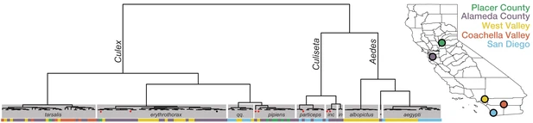
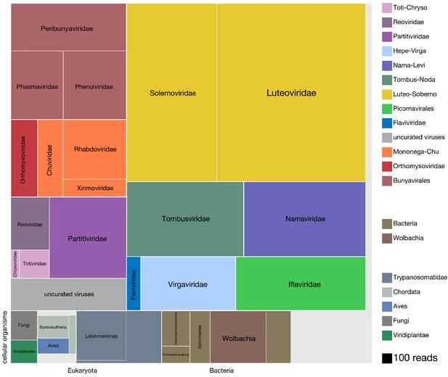
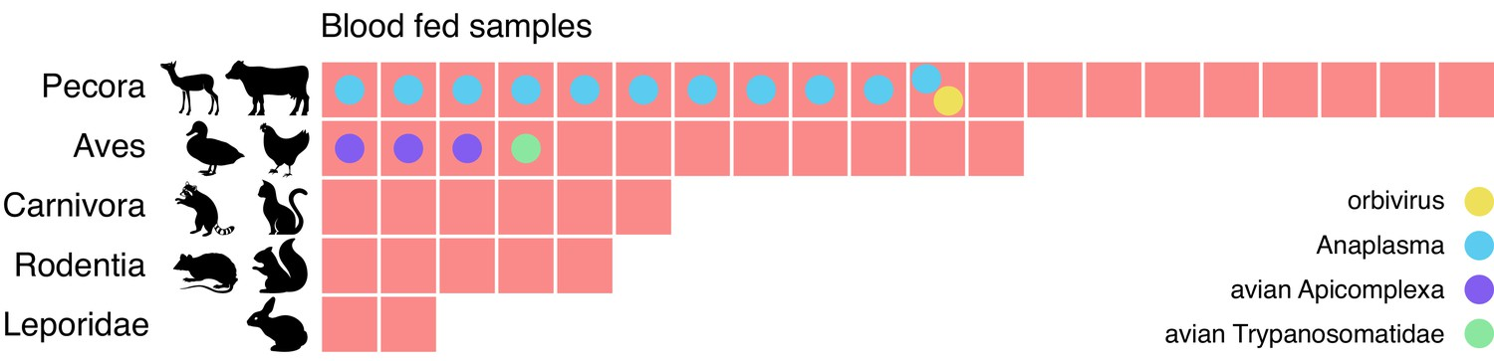
Use case: Batson et al., eLife 2021
mNGS to identify vectors, emerging pathogens, and reservoirs
mNGS on 148 wild mosquitoes reveals:
Mosquito speciation by geography
Microbial composition of mosquitoes
Sources of blood meals in individual mosquitoes

Slide 32
Use case: Batson et al., eLife 2021
mNGS to identify vectors, emerging pathogens, and reservoirs
mNGS on a single sample type gives such rich biological information!
Mosquito speciation by geography
Microbial composition of mosquitoes
Sources of blood meals in individual mosquitoes

Slide 33
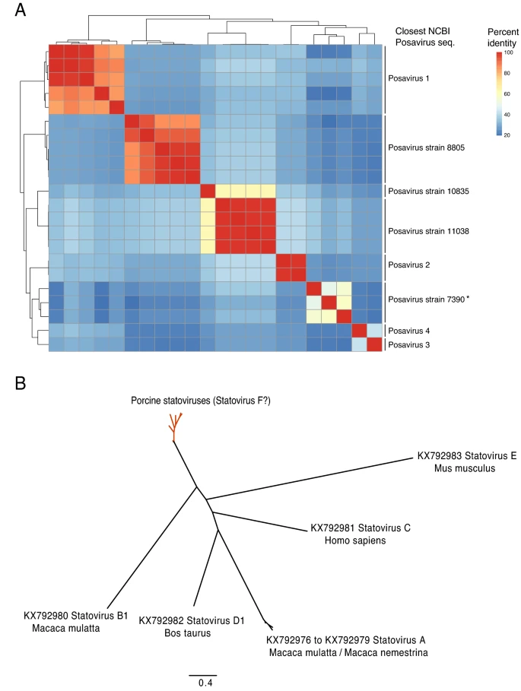
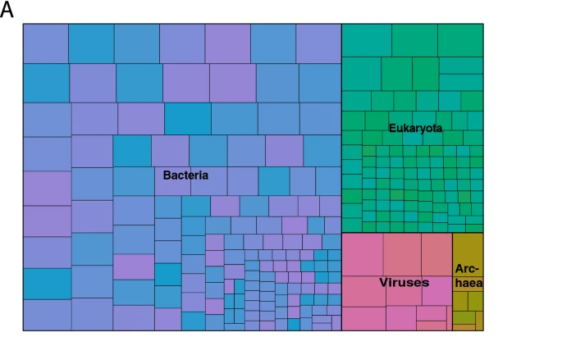
Use case: Ramesh et al., Scientific Reports 2021
Metagenomic characterization of swine slurry in a
North American swine farm operation
1792 viral genomes, of which 554 were novel or divergent!!!

Slide 34
xNA extraction

Slide 35
xNA extraction
Key points:
✓ Minimize cross-contamination
✓ Preserve sample quality
Before extraction:
  Spin down to remove host cells (extract supernatant)
Choose type:
  DNA:
    Detect bacteria, parasites, fungi, DNA viruses
  RNA:
    All the above + RNA viruses (!)
    Requires optimal sample quality, degrades very fast
    Keep cold at all times!
  TNA (total nucleic acid):
    DNA + RNA
    Requires DNAse I step for RNA-mNGS
Column vs bead-based extraction
Notes:
Before extraction, try to get rid of as much host material as possible, by for example spinning down the material and using the supernatant for extraction.
Nucleic acid type depends on your research question since it will affect what you’ll be able to pick up: go for RNA if you are also interested in viruses, provided you have good sample quality. If just interested in bacteria, you can do DNA.
TNA: extract both DNA and RNA, and decide later what type of library you’ll prepare.
Column vs bead-based extraction: Bead-based extractions are easier to perform, especially when working with larger sample sizes.. You will need magnetic stands though. Whatever type of extraction you do, it will be crucial to avoid cross-contamination as much as possible. You can do this by interspersing samples with water controls during extraction, for example. Also make sure to preserve sample quality, this will be especially important when extracting RNA. Avoid freeze-thaw cycles of RNA and keep it cold at all times.

Slide 36
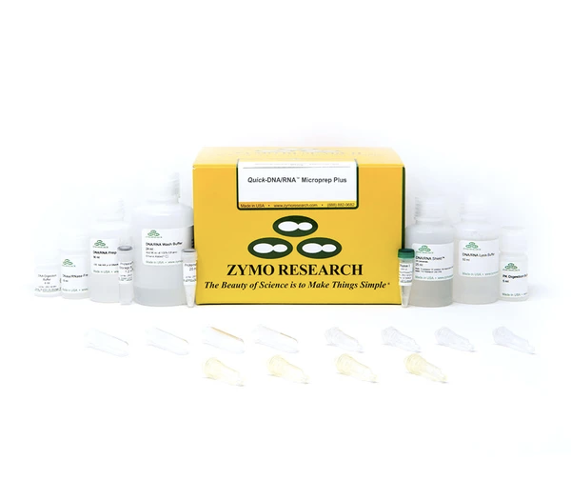
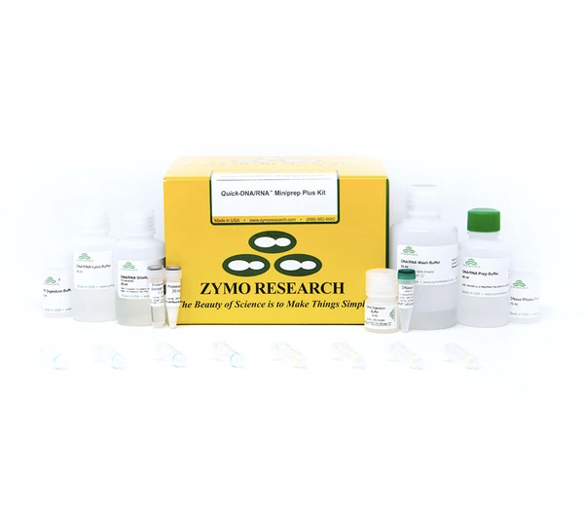
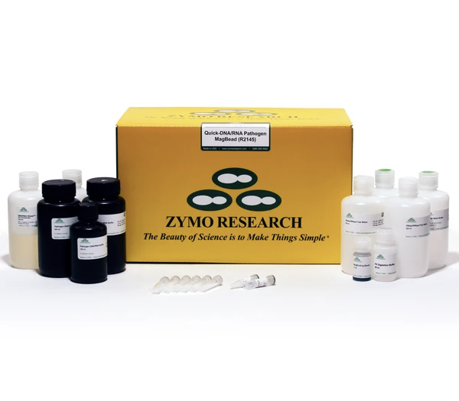
xNA extraction
Zymo DNA+RNA extraction kits
Quick-DNA/RNA Microprep Plus
Quick-DNA/RNA Miniprep Plus
Quick-DNA/RNA Pathogen Magbead
50 preps for $399
50 preps for $399
96 preps for $293
Column-based
Column-based
Bead-based
Requires extra:
Magnet stand (CZB Engineers)
β-mercaptoethanol
Extra reagents to buy:
Molecular grade ethanol (200 proof) for washes
Isopropanol to add to concentrated wash buffers
DNase I included in regular quick-DNA/RNA kits, but not in Pathogen kits
  Available separately from Qiagen: RNase-Free DNase Set, $512 for 250 samples
Notes:
Amount of pathogen can be very low (eg CSF) -> microkit or Magbead kit.
Clogging issue for columns (use Proteinase K! see protocol serum/plasma), but not with magbead (also includes Prot K). BME will also help degrade cell walls, …
DNA/RNA kits are more expensive than just the DNA or RNA kit, but worth it coz you’ll have both
Note: Pathogen magbead is about 20% cheaper than the regular magbead kit for 96 samples, mainly because Path kit does not include DNAseI while regular kit does have it.

Slide 37
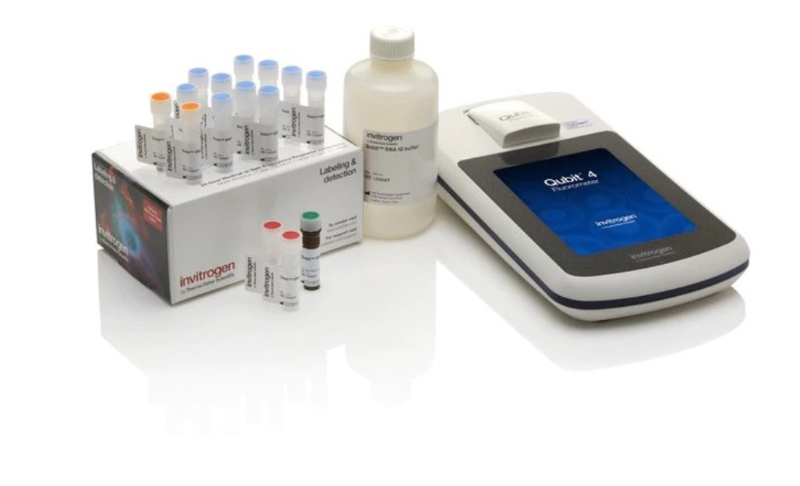
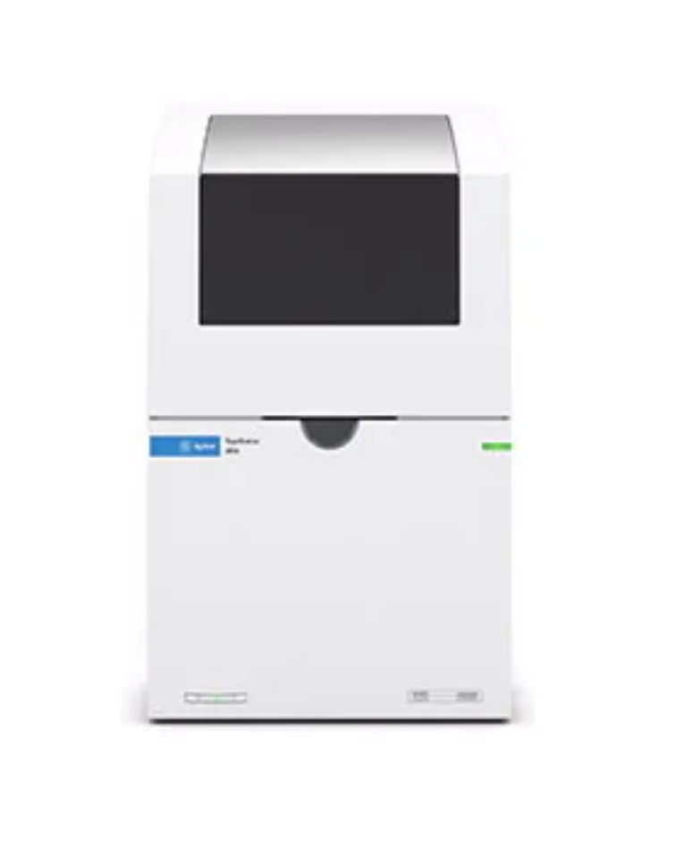
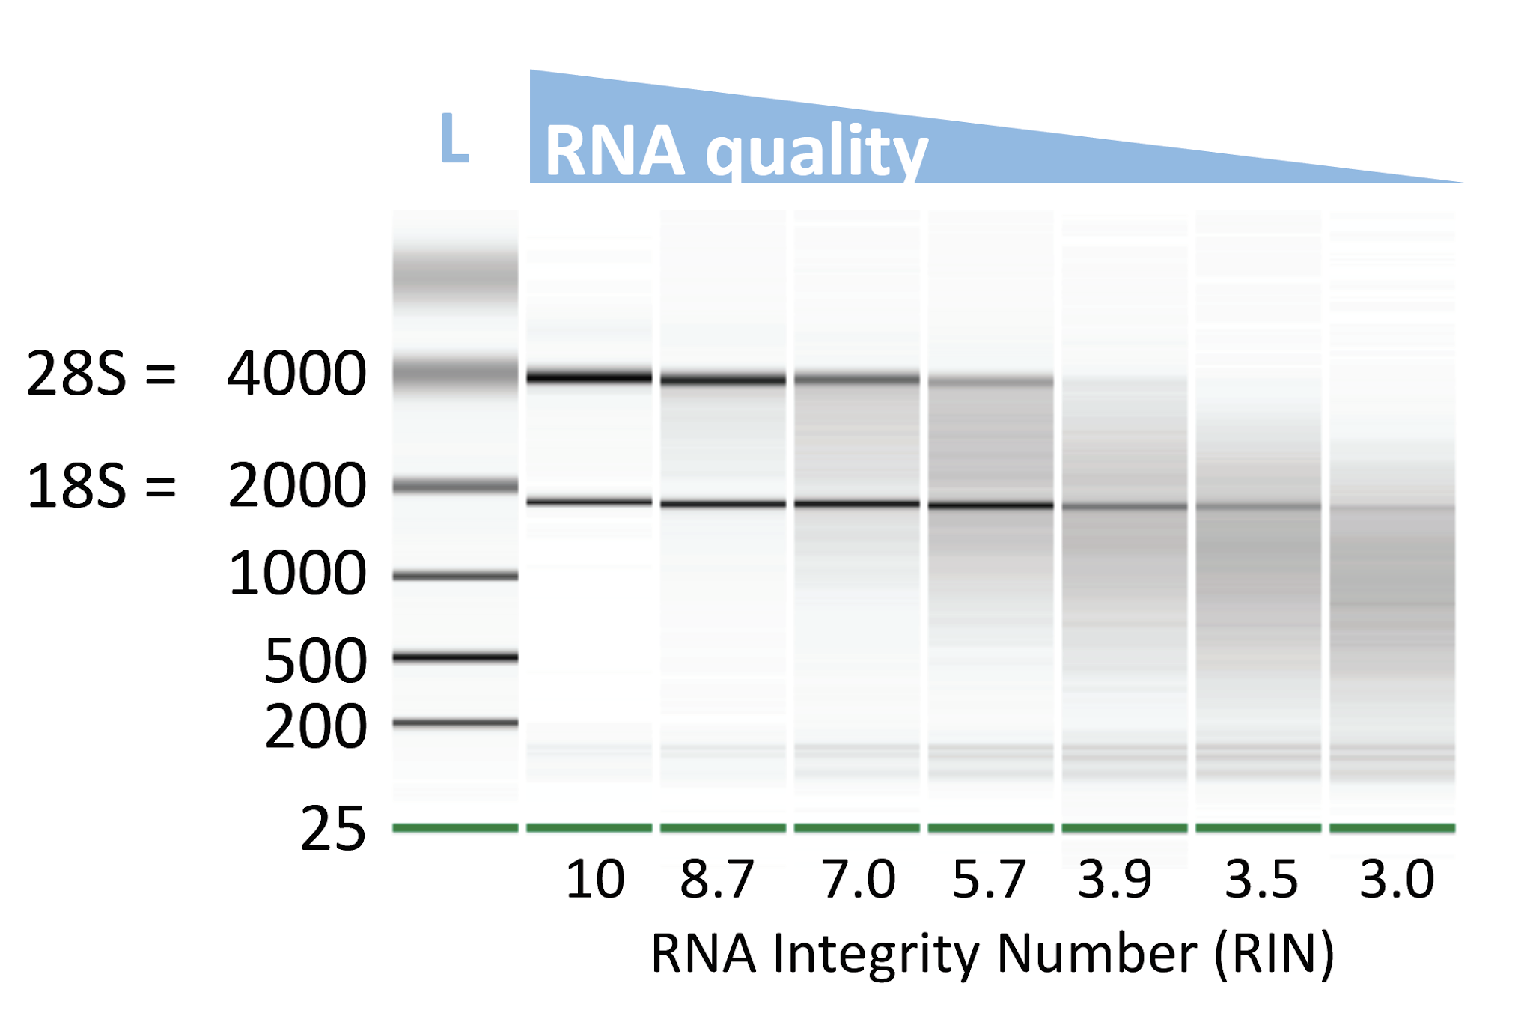
xNA extraction
Key point:
✓ xNA quality is crucial
Quality control:
  Quantity (ng/μl):
    Qubit: RNA or DNA High Sensitivity (HS) Assay Kit (ThermoFisher)
  Quality (length):
    Capillary electrophoresis
      Tapestation (Agilent)
      High Sensitivity DNA or RNA ScreenTape
    Gel electrophoresis
      Regular agarose gel for DNA
      TBE-urea gel for RNA
Notes:
After extraction, it’s important to assess sample quality, as that will have a major impact on the downstream steps of library preparation and eventually the quality of your sequencing data. Quality is defined by not only the concentration of nucleic acid, but also the length of your extracted DNA or RNA. The best way to measure concentration is by Qubit fluorometer. This will give you much more accurate values than a UV-absorbance based method, like the Nanodrop.
To assess quality or length, capillary electrophoresis is the most sensitive method, using a Tapestation or a Bioanalyzer for example. But you could also do gel electrophoresis but you’ll lose more material with that. The graph on the right shows the profiles you can expect from samples with high to low RNA quality. If high quality, the ribosomal RNA peaks will be very prominent, either 28S and 18S when a lot of human RNA is present, or 23S and 16S when its mostly bacterial RNA. Some machines will automatically assign a RNA Integrity Number or RIN to samples, which are a measure for RNA quality. Knowing the quality of your RNA is important, as it will inform you on how long you you’ll need to fragment your nucleic acid in the first steps of library prep.

Slide 38
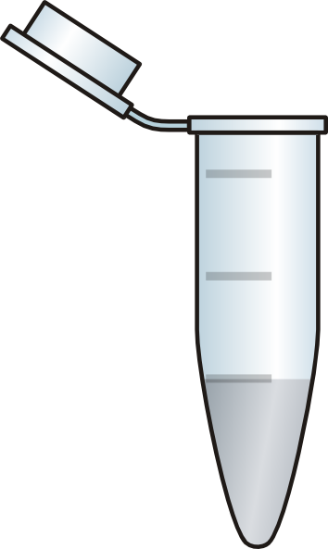
xNA extraction
Keep in mind:
Magnetic stands for 1.5 ml tubes usually accommodate only 8 tubes at a time
Cross-contamination should be avoided as much as possible!!
  Process samples with high pathogen content separately from samples with low pathogen content (if you can)
  Use water controls to estimate the level of cross-contamination
    Space out samples with water controls, and/or empty spots in the magnetic rack
    E.g. for 4 samples:
sample
H₂O
sample
H₂O
sample
H₂O
sample
empty

Slide 39
Next : 03_Lab setup and sample prep

